Slide 1

Limestone, oil, fractional distillation

Slide 2
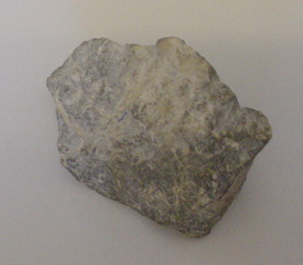
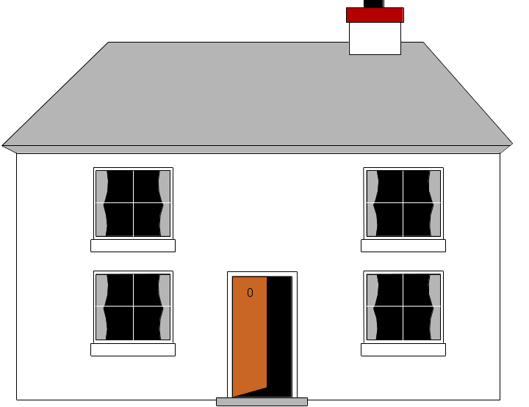
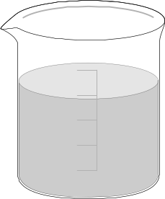
Limestone
Limestone is a __________ rock made up of mainly calcium carbonate. It’s cheap and easy to obtain. Some uses:
1) Building materials – limestone can be quarried and cut into blocks to be used in _______. However, it is badly affected by ____ ____.
2) Glass making – glass is made by mixing limestone with _____ and soda:
Limestone + sand + soda glass
3) Cement making – limestone can be “roasted” in a rotary kiln to produce dry cement. It’s then mixed with sand and gravel to make _______.
Words – sand, building, sedimentary, concrete, acid rain

Slide 3
Limestone
If soil is too _____ crops will fail. Limestone can also be used as a neutralising agent. There are two reactions to know:
1) Firstly, a THERMAL _________________ reaction is used to break the calcium carbonate down into calcium oxide (quicklime) and _______ __________:
HEAT
Calcium carbonate calcium oxide + carbon dioxide
2) This is then “slaked” with water to produce calcium hydroxide (“_________ lime”):
WATER
Calcium oxide calcium hydroxide
Calcium hydroxide is alkaline and is used to ______ acidic soil.
Words – slaked, acidic, neutralise, decomposition, carbon dioxide

Slide 4
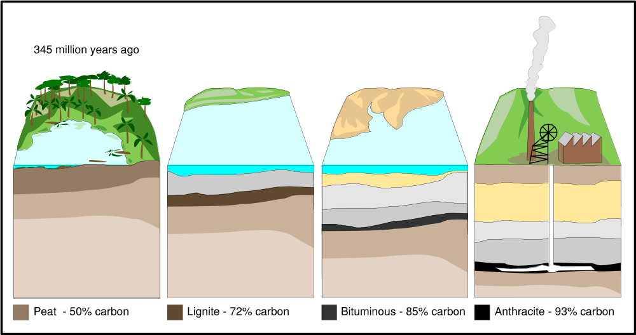
Formation of oil and gas
1) Layers of dead sea _____ settle on the seabed.
2) Layers of __________ rock build up on top.
3) The heat and ________ from these rocks, along with the absence of ______, mean that oil and gas are formed over ______ of years.
Words – sedimentary, millions, oxygen, creatures, pressure

Slide 5
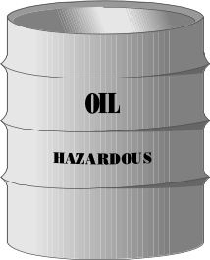
Hydrocarbons and crude oil
Crude oil is a mixture of HYDROCARBONS (compounds made up of carbon and hydrogen). Some examples:
H
H
Longer chains mean…
Less ability to flow
Less flammable
Less volatile
Higher boiling point
H
C
C
H
H
H
Ethane
Increasing length
H
H
H
H
H
C
C
C
C
H
H
H
H
H
Butane

Slide 6
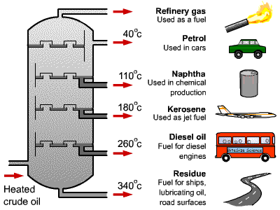
Fractional distillation
Crude oil can be separated by fractional distillation. The oil is evaporated and the hydrocarbon chains of different lengths condense at different temperatures:
Fractions with low boiling points condense at the top
Fractions with high boiling points condense at the bottom

Slide 7
This powerpoint was kindly donated to www.worldofteaching.com
http://www.worldofteaching.com is home to over a thousand powerpoints submitted by teachers. This is a completely free site and requires no registration. Please visit and I hope it will help in your teaching.

